Slide 1
Evaporation Rate Calculation Cannon Air Force Base, Clovis, New MexicO

Slide 2
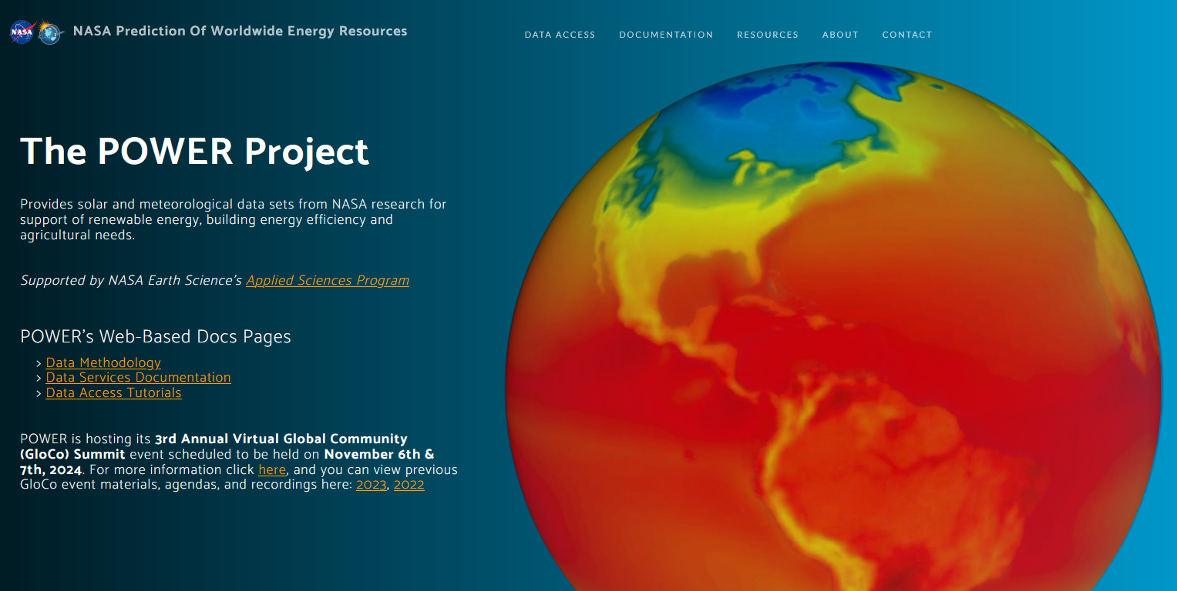

Resources
NASA POWER Data - https://power.larc.nasa.gov/
PRISM Data - https://prism.oregonstate.edu/
Latitude = 34.3898
Longitude = 103.3183
Elevation = 1310 m

Slide 3
Codes and Used Data
https://github.com/aaloksk/PET
Reference Evapotranspiration (RET) Values
Considering short grass clipped to 0.12m height
Considering both aerodynamic (wind) and radiation (solar) as components of ET.

Slide 4
